Slide 1


Interoperable Simulation and Gaming sprint
3D Data & API Standards

Slide 2
The goal of the Sprint was to advance the use of relevant OGC and Khronos standards in the modeling and simulation community through practical exercise and testing of the draft specification produced by the 3D Data Container and Tiles API Pilot.
Of particular interest was the handling and integration of glTF models coming from multiple sources.
SPRINT GOAL – SCENARIO 1
Notes:
CAE’s focused for the event was the translation of CDB to glTF and 3D Tiles.

Slide 3





Data Generation and Data Sharing
TEAMWORK

Slide 4


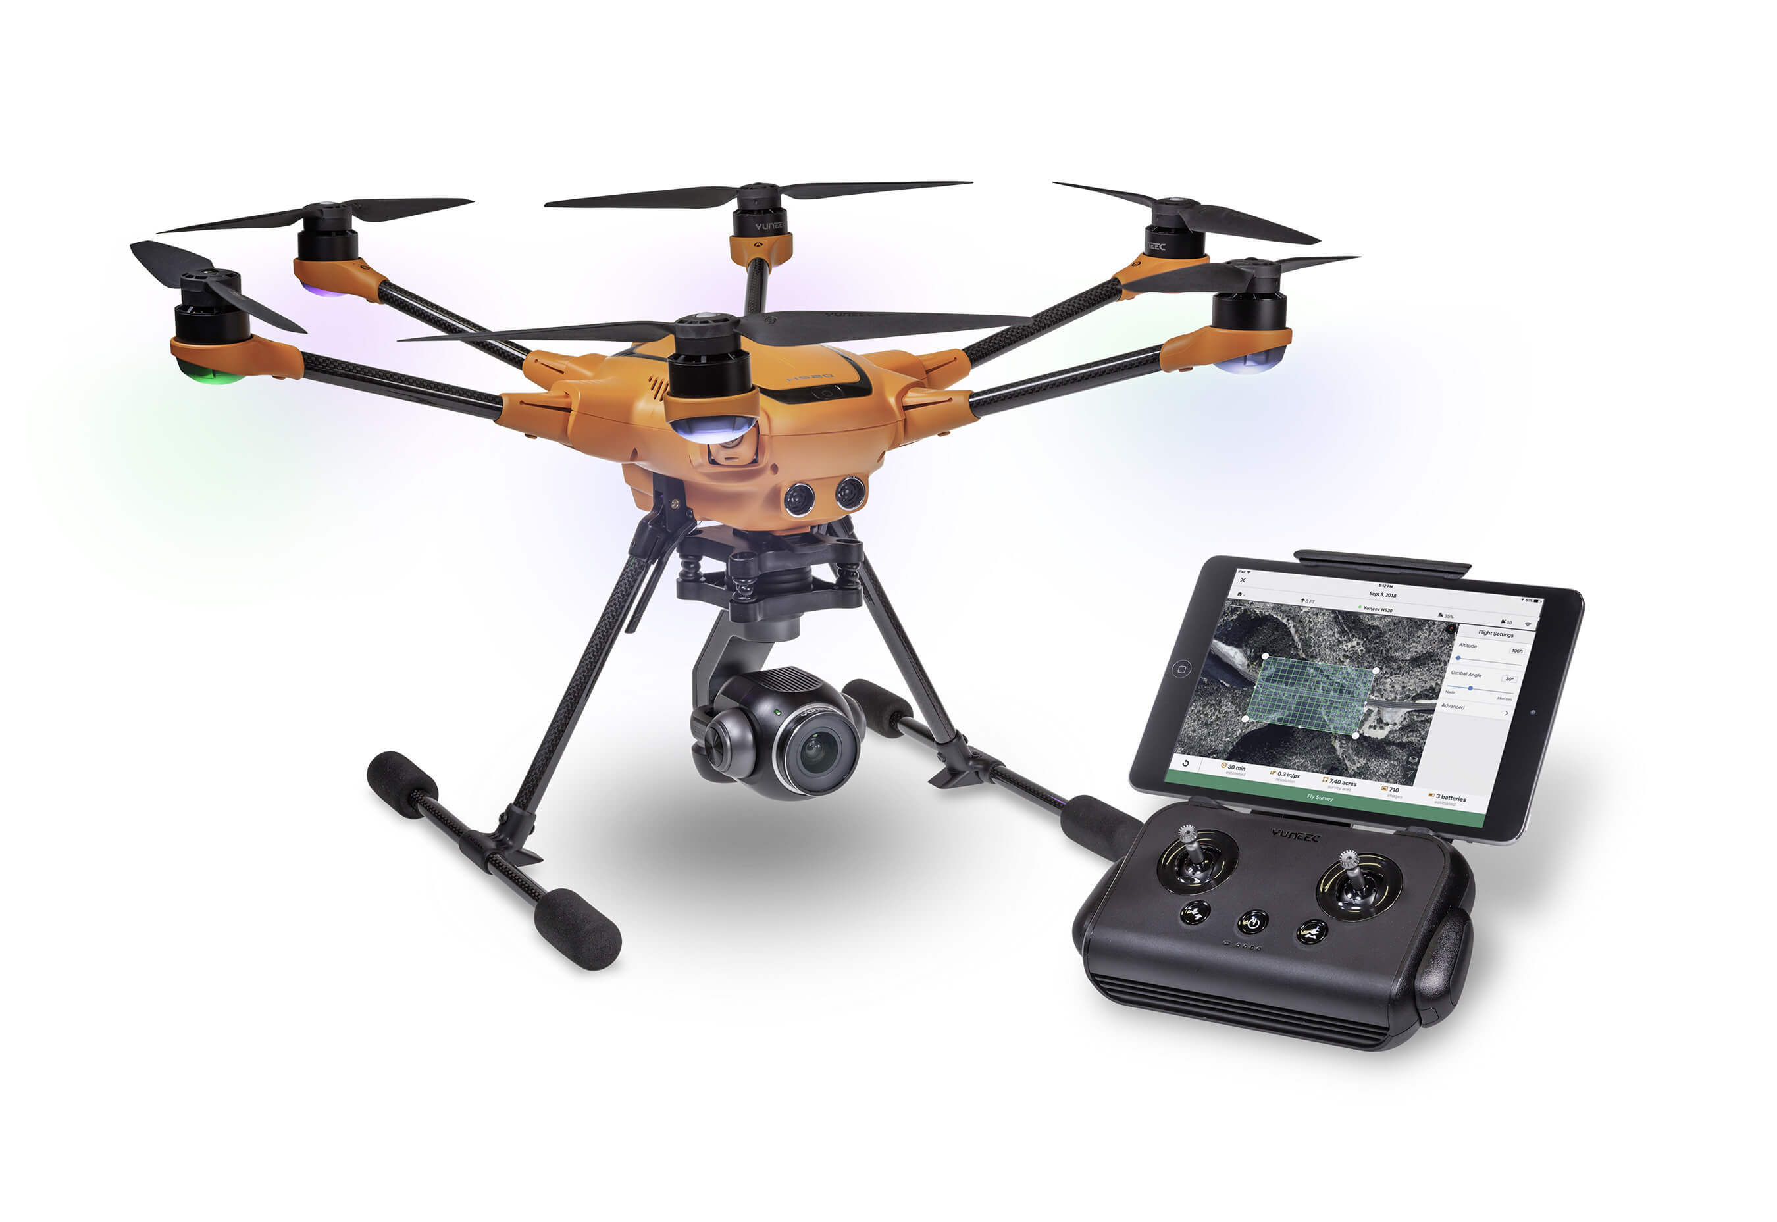

CAE DATA GENERATION
Notes:
The workflow we followed for data generation. Began with a CAE CDB dataset.
The dataset was supplemented by the addition of full motion video, converted to point cloud, and then to CDB
The CDB was then exported as both 3D Tiles and a single glTF model.

Slide 5
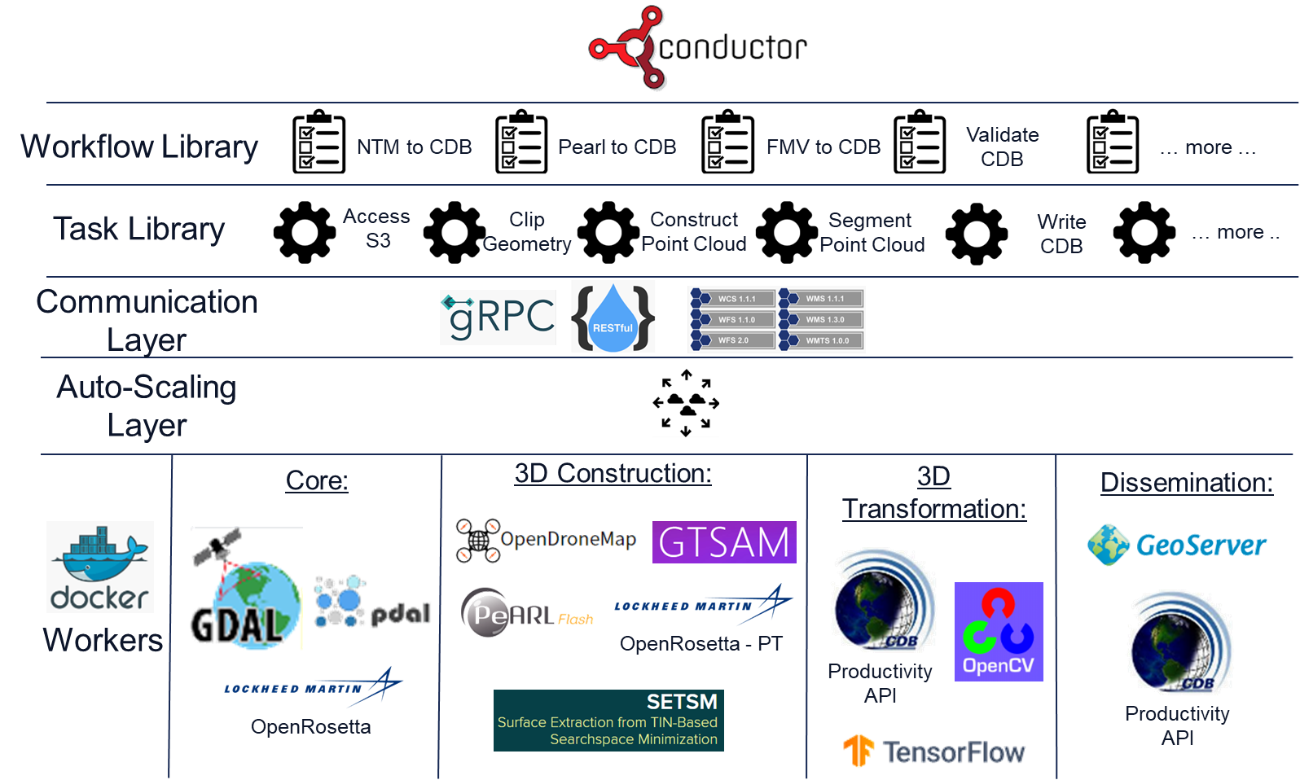


Joining Technologies into One Cohesive Architecture
Notes:
Data Generation exercised both the Rapid 3D and Foundation GEOINT in 3D architecture

Slide 6
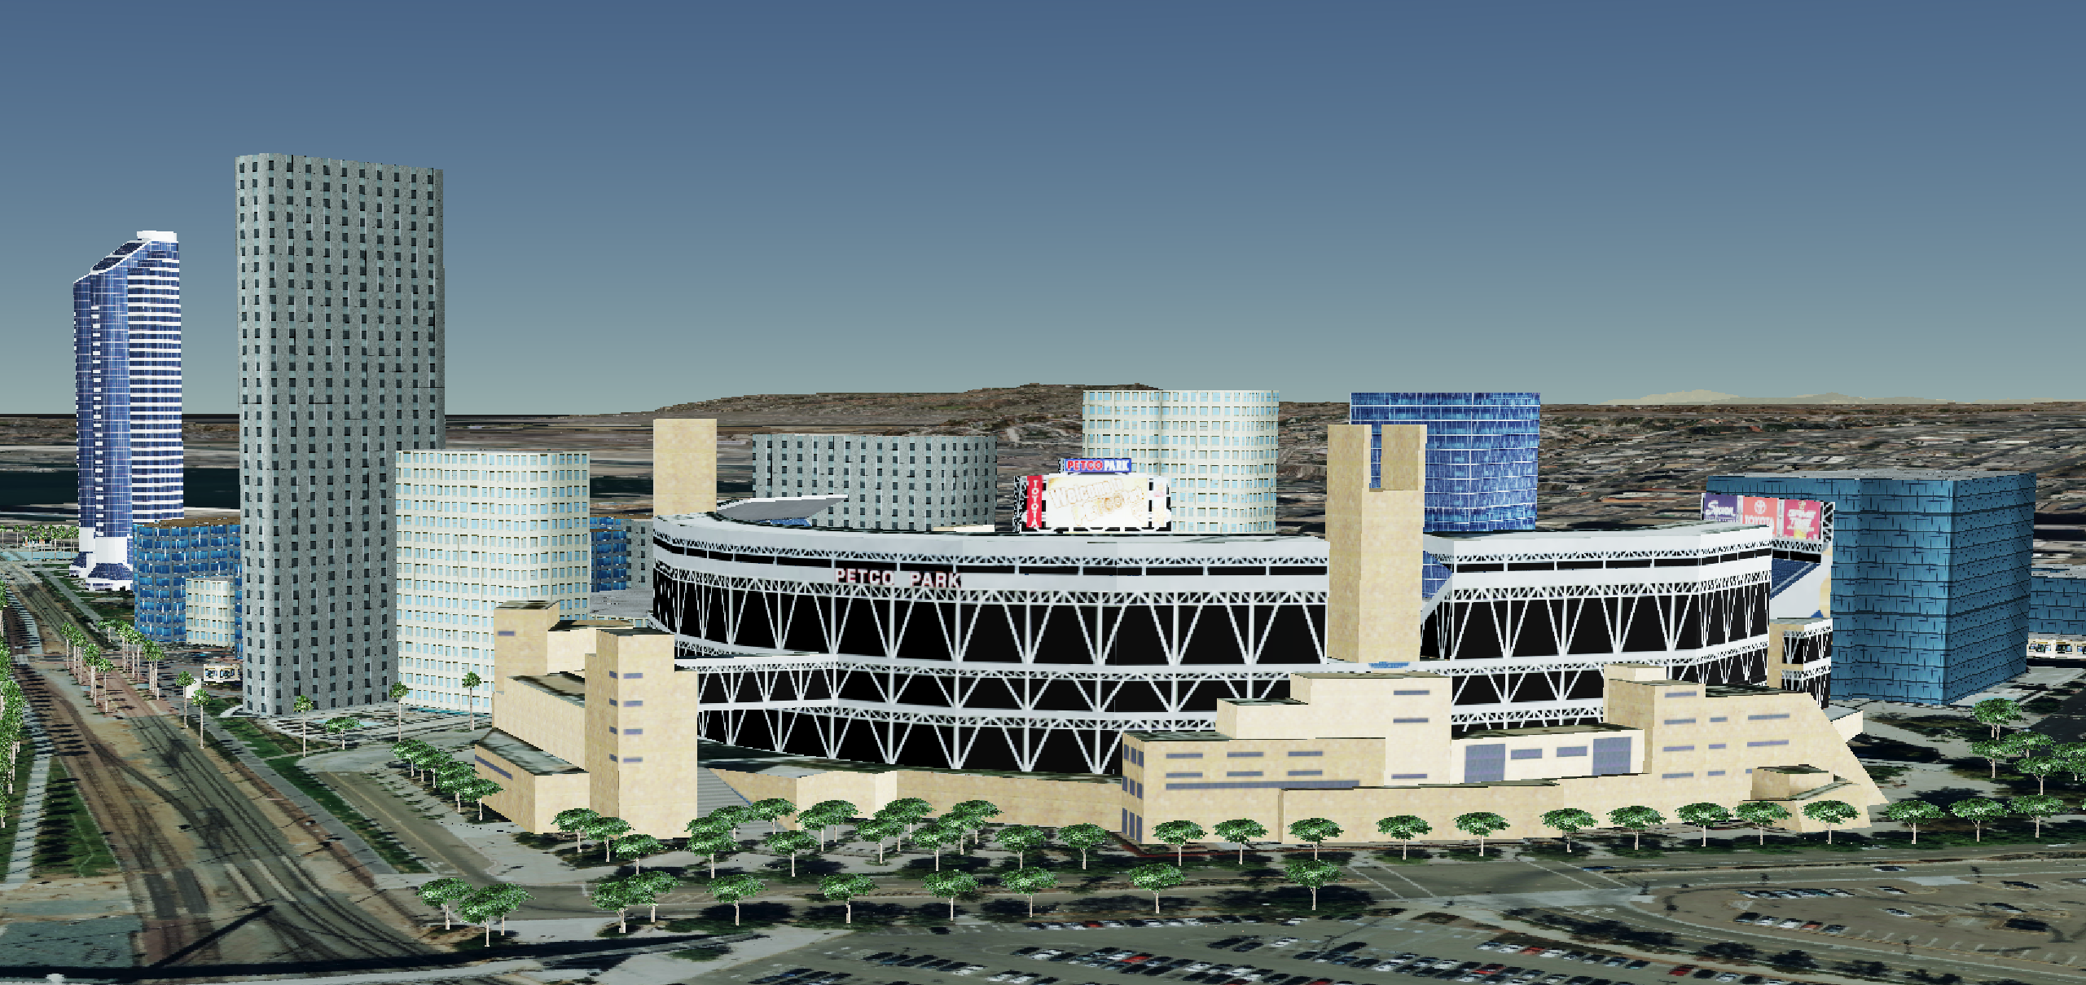
INTEGRATED 3D SCENE
Notes:
With the end goal to render the 3D Tiles and glTF in the 3D scene for feasibility and data analysis.

Slide 7
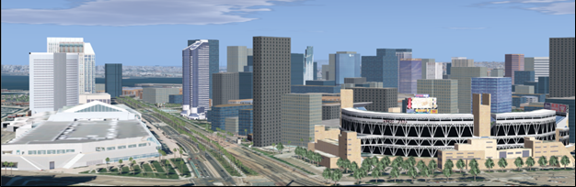
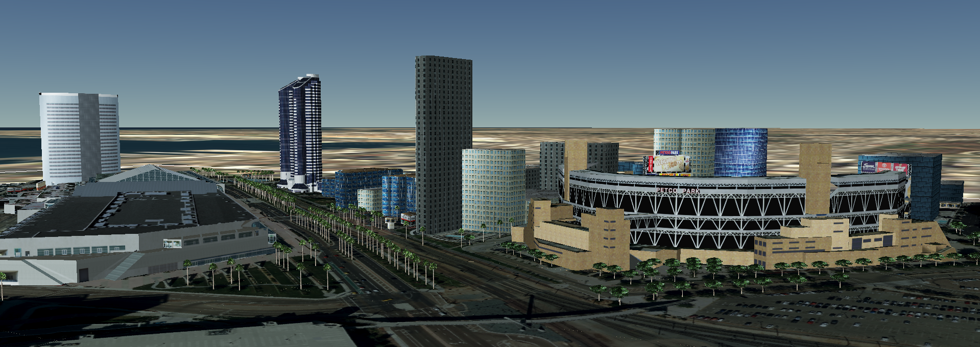
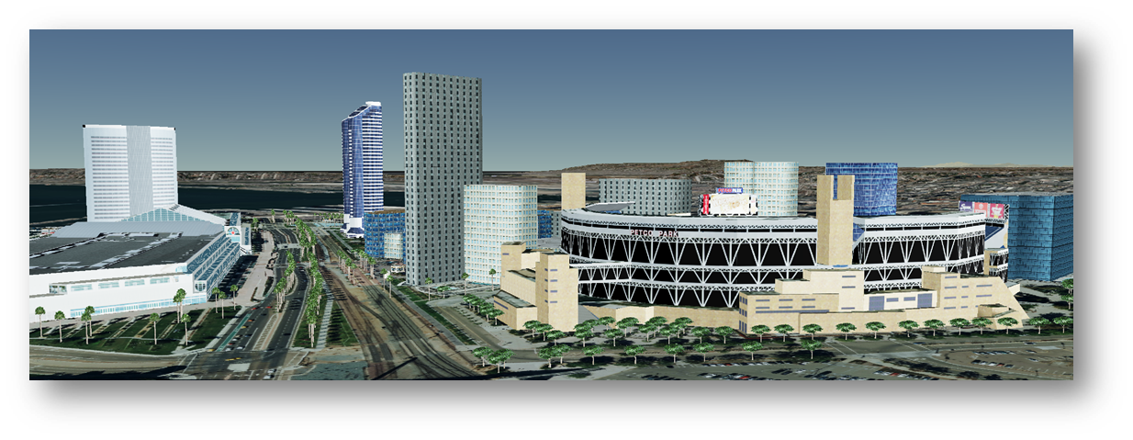
Data Analysis
VegaPrime
CDB
Cesium ion
3D Tiles
CAE Dragonfly
3D Tiles
Notes:
Compared original source CDB to the converted 3D Tile output

Slide 8

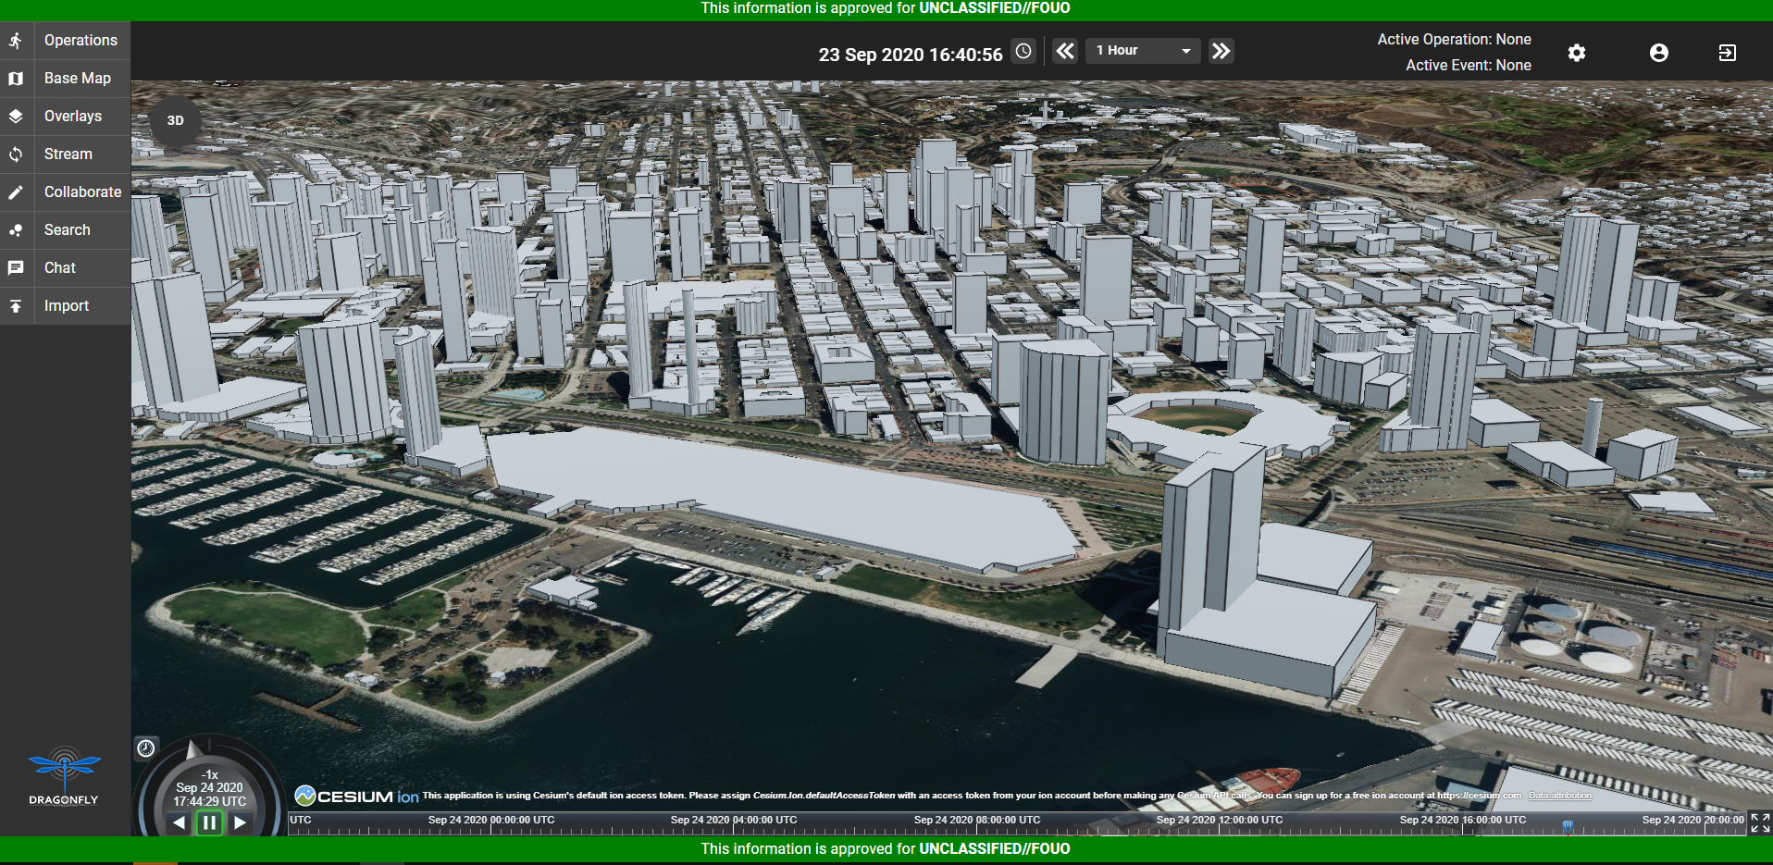
3D Tiles from Open Street MAP
ORIGINAL CONTENT SCENE
CESIUM 3D TILES

Slide 9

CAE DRAGONFLY
3D TILES & glTF INTEGRATED SCENE

Slide 10

For more detail please see the
OGC ISG Sprint Engineering Report
CDRL A005 – CDB Rapid Prototyping Combined IPR #10 Presentation Material UNCLASSIFIED Distribution subject to the restrictions on the title page

Slide 11
CAE USA Inc.
12249 Science Dr., Suite 200
Orlando, FL 32826
Created for
OpenGeospatial Consortium Interoperable Simulation and Gaming Sprint
21-25 September 2020

